Slide 1

Introduction to Neural Networks
Data Science Immersive
Notes:
https://towardsdatascience.com/the-mostly-complete-chart-of-neural-networks-explained-3fb6f2367464
Can think of neural nets as a general way of representing levels of abstraction. Logistic regression -> no hidden layer; one hidden layer, and two hidden layers etc

Slide 2
Agenda today
A brief history of Neural Networks
Motivations for Neural Network
Intuition of NN - hidden layers, forward propagation, and backpropagation

Slide 3
Students will be able to...
Understand the motivation and need for neural nets
Understand and explain the similarity and difference between linear regression and neural nets
Explain the intuition behind a vanilla neural net

Slide 4
Neural Networks as representation learning
So much of machine learning is using mathematics and statistics to represent how we as human perceive, interpret and make sense of certain phenomena
Natural Language Processing
Decision Trees
Linear regression
Neural network is no exception - it is originally used to model how our neurons activate when presented with certain stimuli

Slide 5
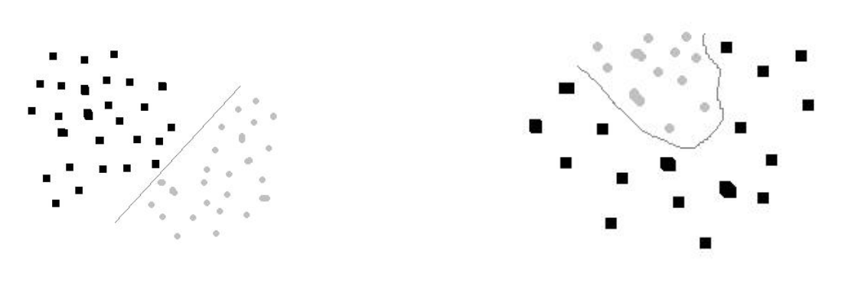
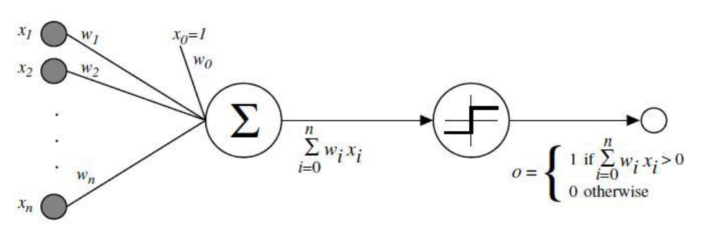
Brief History of Neural Networks
Motivated by the desire to harness the thinking process, William McCulloch and Walter Pitts wrote a paper on how neurons might work by modeling the logical process of AND/OR/NOT in 1943
Inspired by Pitts and McCulloh, Hebb published Organization of Behavior in 1949 which proposed that neural pathways are strengthened each time after stimulation
Frank Rosenblatt, a Psychologist, created the first Perceptron (Mark I Perceptron) 1958 that is capable of separating linearly separable cases, but failed at non-linear ones.
Research later found out that the Mark I perceptron did not fail at its ability to make prediction, but scale
Notes:
Pitts and McCulloch’s research is simplistic and doesn’t incorporate the aspect of learning. Therefore Hebb incorporate and improved the research by proposing aspects of Learning - “cells that fire together, wire together”

Slide 6



Brief History of Neural Networks
Research in NN was dormant for a while until the advent of backpropagation emerge (1975), which effectively solved the problem of non-linearly separable cases by creating multiple layers and train the weights and biases by propagating the error term back up through the layers.
Max-pooling is introduced in 1992
Between 2009 and 2012, recurrent neural nets were developed
Ian Goodfellow and others developed GANs (Generative Adversarial Networks)
Notes:
A key trigger for renewed interest in neural networks and learning was Werbos's (1975) backpropagation algorithm that effectively solved the exclusive-or problem by making the training of multi-layer networks feasible and efficient. Backpropagation distributed the error term back up through the layers, by modifying the weights at each node.
Max pooling is a step in cnn that reduces certain biases in a layer to help improve prediction.

Slide 7
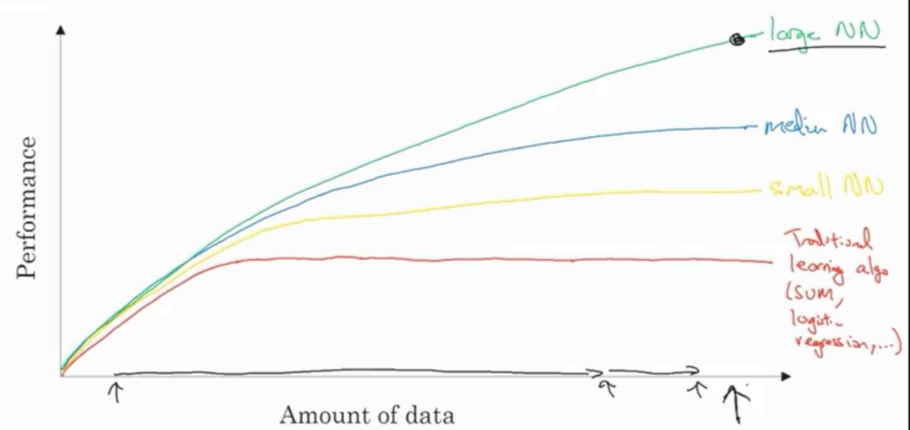
Why Neural Networks?
Why have neural networks really taken off and became a major area of research in the past few years?
Notes:
NN has taken off due to the available computational power that we are able to harness in the past years. NN can be extremely computationally expensive especially with large sets of data, but with available power, we are able to achieve high prediction performance with large set of data.
Scale is driving neural networks - both in terms of the size of the network and the size of the data used to train them. For smaller set of data, you need to engineer more features but as you scale you do not need to do as much feature engineering

Slide 8
Why Neural Networks?
Data
Computation
CPU and GPU
Algorithmic improvements
Changing activation function to make your nn run faster
Notes:
Improving activation function

Slide 9
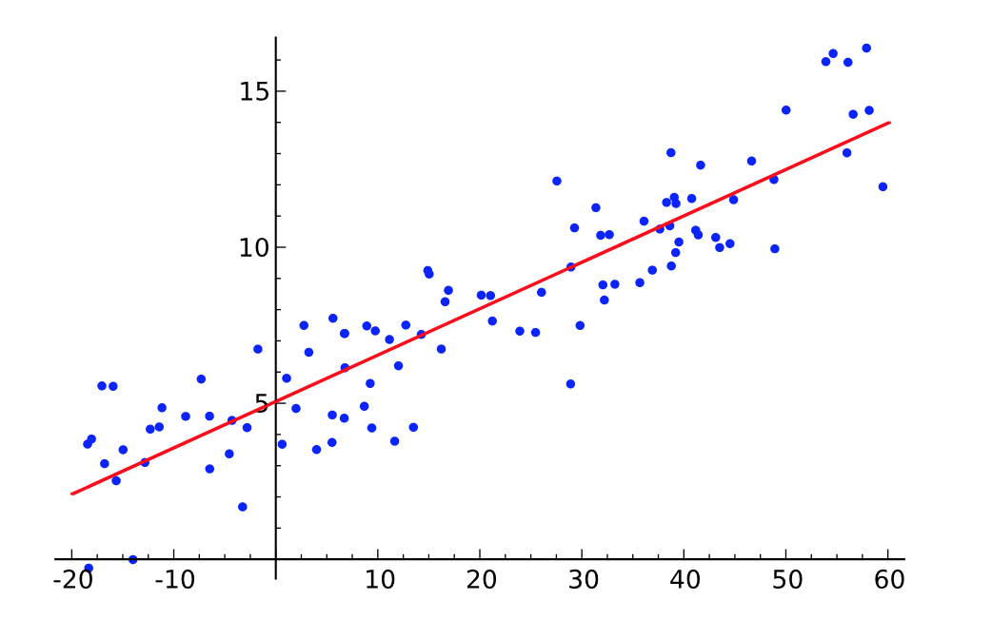
Why Neural Nets?
Before jumping into concepts in artificial neural networks, let’s revisit our old friend linear regression
Predict the price of a house based on the following features
Square Footage
Age
Neighborhood
Lot size
Notes:
Linear regression model input and output as linear combination of each other. However, in the real world, relationship between variables are not usually linear.
One of the important assumption of linear regression is the the outcome is the linear combination of its individual parts (outcome -> sum of its parts), but in the real world there is a lot of interaction happening.

Slide 10
Why Neural Nets?
Model with no interactions
Model with interactions
Neighborhood A
Neighborhood A
Price
Price
Neighborhood B
Neighborhood B
Square Feet
Square Feet
Notes:
Linear regression model input and output as linear combination of each other. However, in the real world, relationship between variables are not usually linear.
One of the important assumption of linear regression is the the outcome is the linear combination of its individual parts (outcome -> sum of its parts), but in the real world there is a lot of interaction happening.

Slide 11
Why Neural Nets?
Interactions:
Neural Networks account for interactions really well
Deep learning uses powerful networks to work with very complex data
Text
Images
Videos
Audio
Source Code
Notes:
Linear regression model input and output as linear combination of each other. However, in the real world, relationship between variables are not usually linear.
One of the important assumption of linear regression is the the outcome is the linear combination of its individual parts (outcome -> sum of its parts), but in the real world there is a lot of interaction happening.

Slide 12
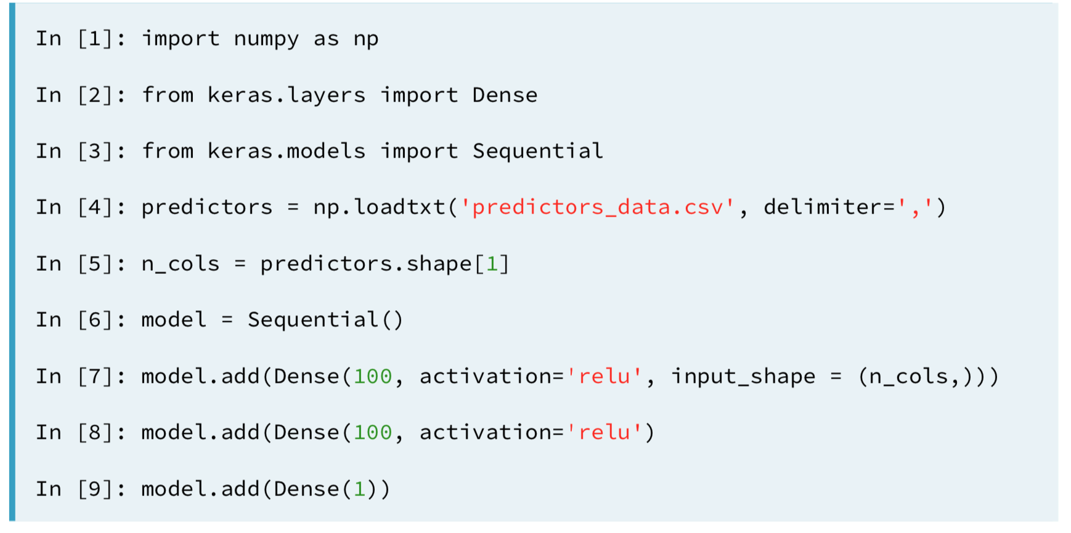
What is Neural Nets?

Slide 13
What is Neural Nets?
An artificial neural network is a network of simple elements called artificial neurons, which receive input, change their internal state (activation) according to that input, and produce output depending on the input and activation.

Slide 14
Why Neural Networks
Input Layer
Hidden Layer
Output layer
Square Feet
Neighborhood
Latent Feature
Price
Lot Size
Age
Notes:
An artificial neural network is a network of simple elements called artificial neurons, which receive input, change their internal state (activation) according to that input, and produce output depending on the input and activation.
Explain the similarity between neural network and linear regression and how neural nets represent the interaction so well.
Deep neural network internally build up representation of patterns in the data, and they go through increasingly complex patterns as we go through successively hidden layers of the networks. Therefore, NN partially replace the need for feature engineering because as the layers increase, the more sophiscated the representations are built from raw data,

Slide 15
Why Neural Networks?
Deep neural network internally build up representation of patterns in the data, and they go through increasingly complex patterns as we go through successively hidden layers of the networks.
Therefore, NN partially replace the need for feature engineering
Because as the layers increase, the more sophisticated the representations are built from raw data
Notes:
Improving activation function

Slide 16
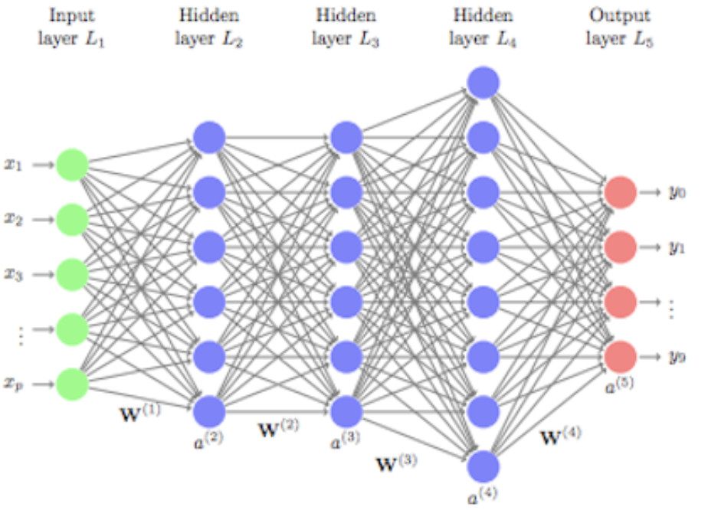
How Neural Nets work?
Notes:
Improving activation function

Slide 17
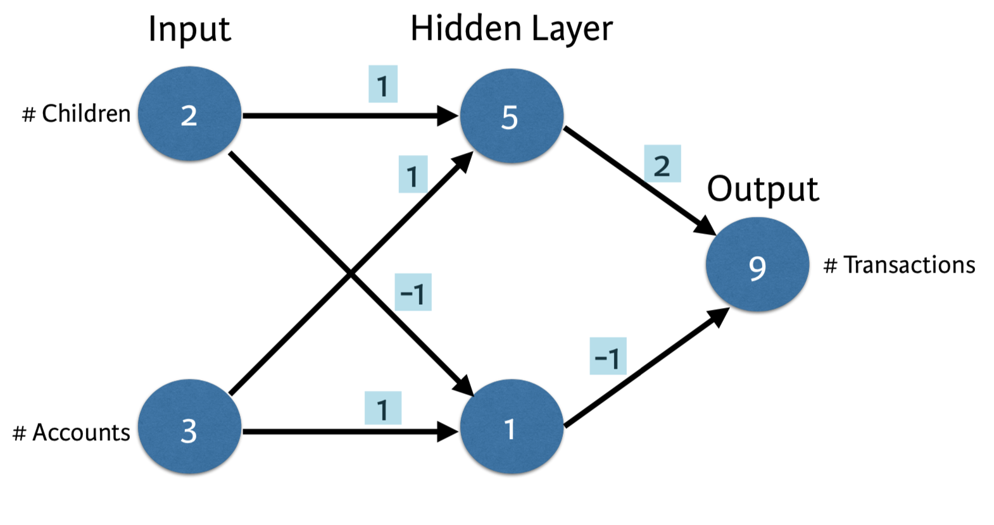
Forward Propagation
Notes:
An artificial neural network is a network of simple elements called artificial neurons, which receive input, change their internal state (activation) according to that input, and produce output depending on the input and activation.
Explain the similarity between neural network and linear regression and how neural nets represent the interaction so well.
Deep neural network internally build up representation of patterns in the data, and they go through increasingly complex patterns as we go through successively hidden layers of the networks. Therefore, NN partially replace the need for feature engineering because as the layers increase, the more sophiscated the representations are built from raw data,

Slide 18
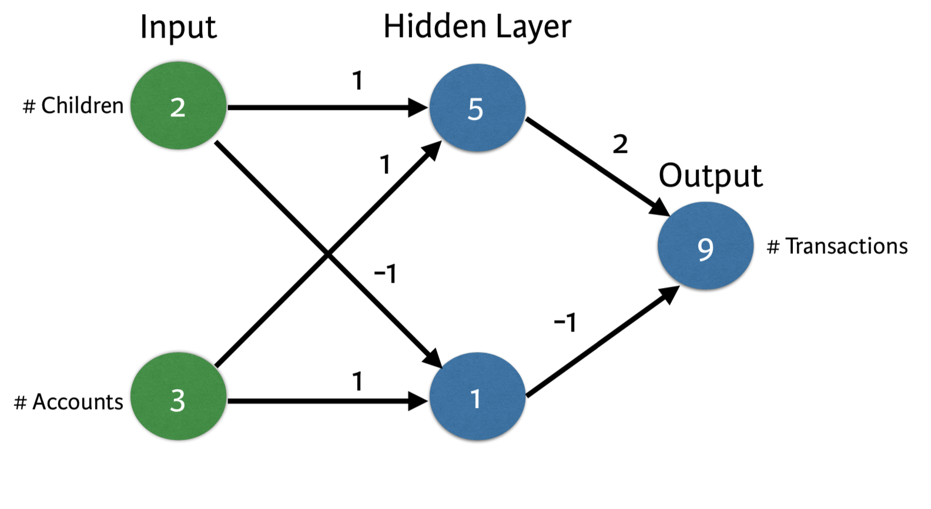
Forward Propagation
Notes:
An artificial neural network is a network of simple elements called artificial neurons, which receive input, change their internal state (activation) according to that input, and produce output depending on the input and activation.
Explain the similarity between neural network and linear regression and how neural nets represent the interaction so well.
Deep neural network internally build up representation of patterns in the data, and they go through increasingly complex patterns as we go through successively hidden layers of the networks. Therefore, NN partially replace the need for feature engineering because as the layers increase, the more sophiscated the representations are built from raw data,

Slide 19
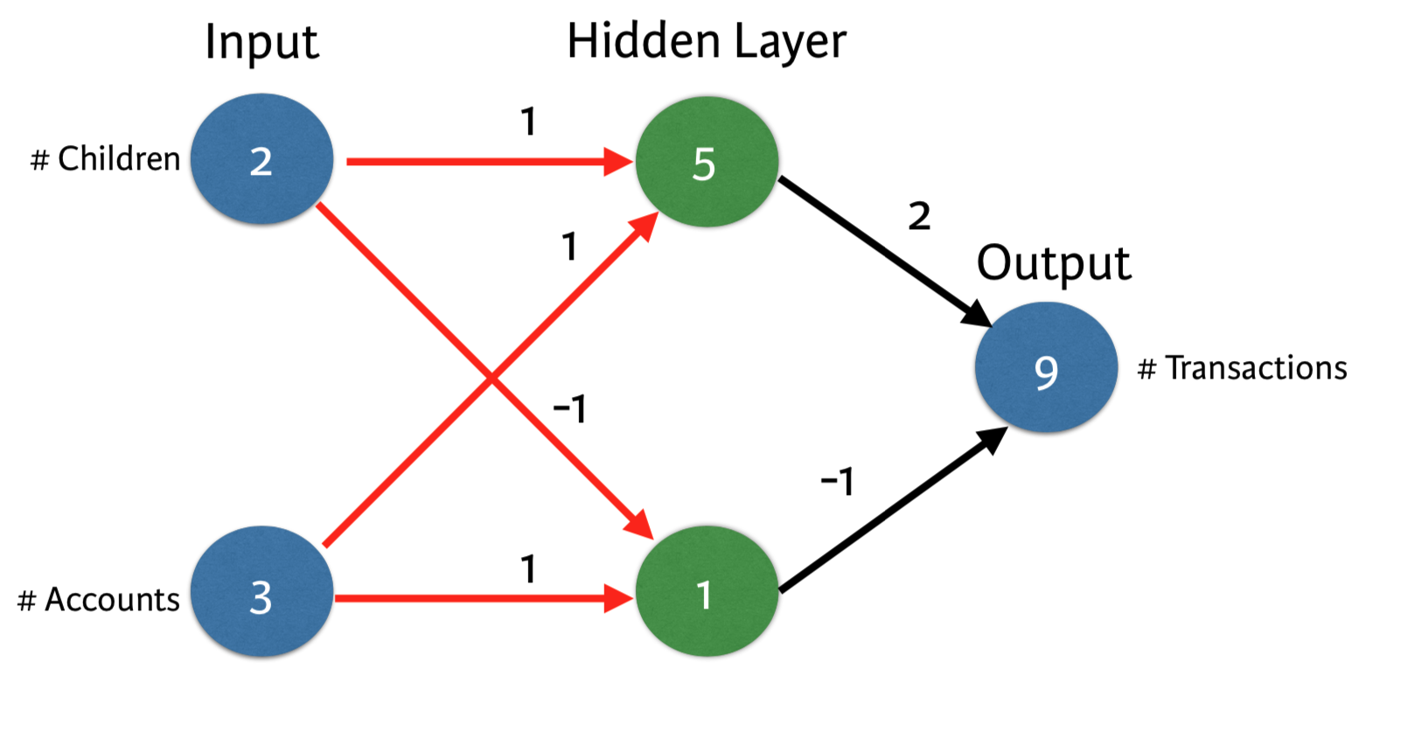
Forward Propagation
Notes:
An artificial neural network is a network of simple elements called artificial neurons, which receive input, change their internal state (activation) according to that input, and produce output depending on the input and activation.
Explain the similarity between neural network and linear regression and how neural nets represent the interaction so well.
Deep neural network internally build up representation of patterns in the data, and they go through increasingly complex patterns as we go through successively hidden layers of the networks. Therefore, NN partially replace the need for feature engineering because as the layers increase, the more sophiscated the representations are built from raw data,

Slide 20
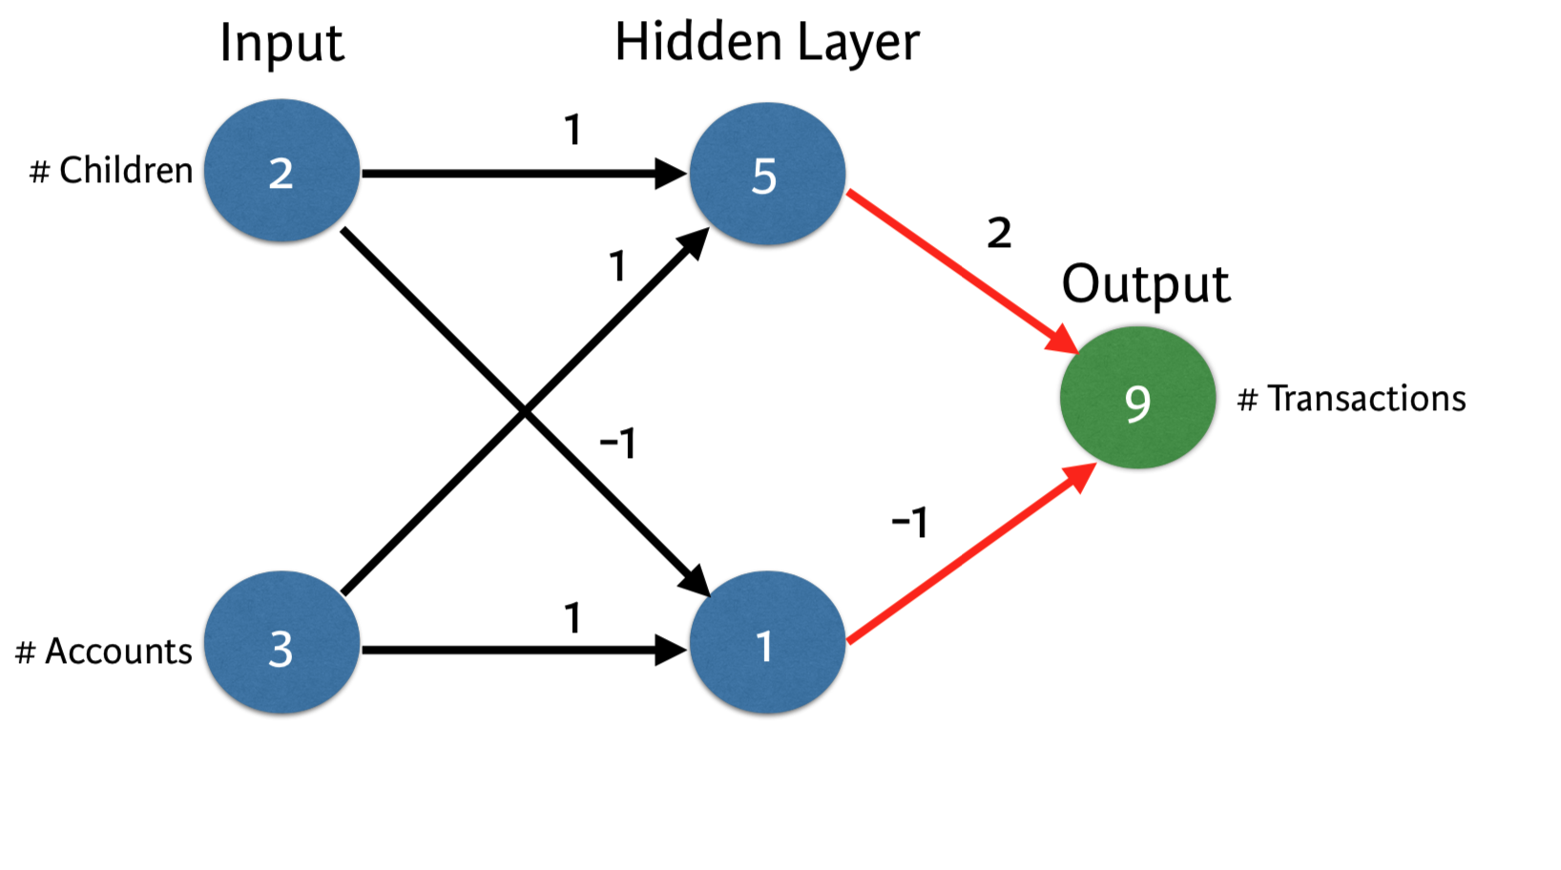
Forward Propagation
Notes:
An artificial neural network is a network of simple elements called artificial neurons, which receive input, change their internal state (activation) according to that input, and produce output depending on the input and activation.
Explain the similarity between neural network and linear regression and how neural nets represent the interaction so well.
Deep neural network internally build up representation of patterns in the data, and they go through increasingly complex patterns as we go through successively hidden layers of the networks. Therefore, NN partially replace the need for feature engineering because as the layers increase, the more sophiscated the representations are built from raw data,

Slide 21
Forward Propagation
Multiply the value of a node by the weight of an edge
Add up all of those which is the dot product
Forward propagate one data point at a time
Output layer is the prediction for that data point
Notes:
An artificial neural network is a network of simple elements called artificial neurons, which receive input, change their internal state (activation) according to that input, and produce output depending on the input and activation.
Explain the similarity between neural network and linear regression and how neural nets represent the interaction so well.
Deep neural network internally build up representation of patterns in the data, and they go through increasingly complex patterns as we go through successively hidden layers of the networks. Therefore, NN partially replace the need for feature engineering because as the layers increase, the more sophiscated the representations are built from raw data,

Slide 22
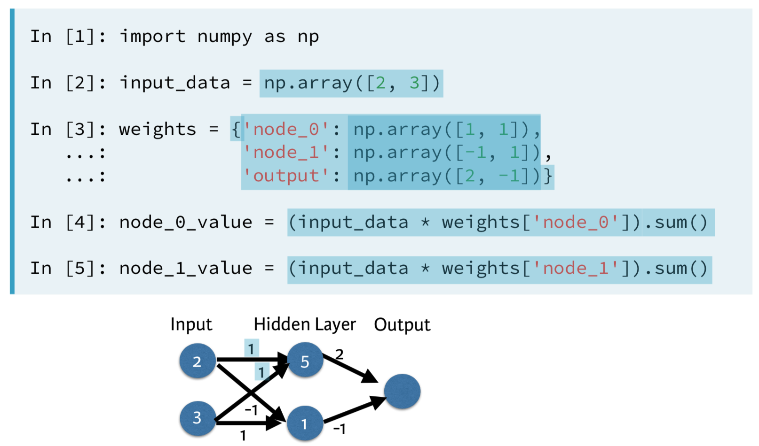
Forward Propagation
Notes:
An artificial neural network is a network of simple elements called artificial neurons, which receive input, change their internal state (activation) according to that input, and produce output depending on the input and activation.
Explain the similarity between neural network and linear regression and how neural nets represent the interaction so well.
Deep neural network internally build up representation of patterns in the data, and they go through increasingly complex patterns as we go through successively hidden layers of the networks. Therefore, NN partially replace the need for feature engineering because as the layers increase, the more sophiscated the representations are built from raw data,

Slide 23
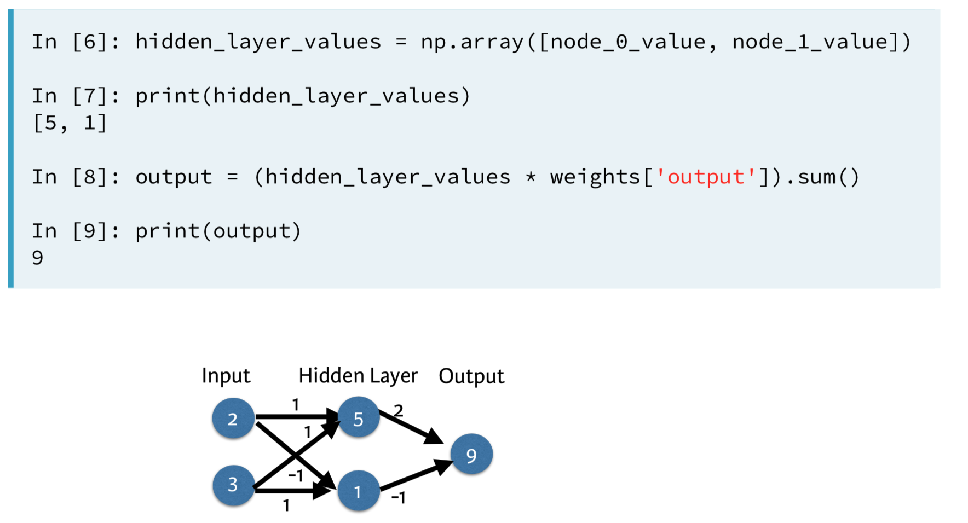
Forward Propagation
Notes:
An artificial neural network is a network of simple elements called artificial neurons, which receive input, change their internal state (activation) according to that input, and produce output depending on the input and activation.
Explain the similarity between neural network and linear regression and how neural nets represent the interaction so well.
Deep neural network internally build up representation of patterns in the data, and they go through increasingly complex patterns as we go through successively hidden layers of the networks. Therefore, NN partially replace the need for feature engineering because as the layers increase, the more sophiscated the representations are built from raw data,

Slide 24
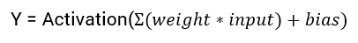
Activation Functions
Activation functions are an extremely important feature of the artificial neural networks. They basically decide whether a neuron should be activated or not. Whether the information that the neuron is receiving is relevant for the given information or should it be ignored.
The activation function is the non linear transformation that we do over the input signal. This transformed output is then sen to the next layer of neurons as input.

Slide 25
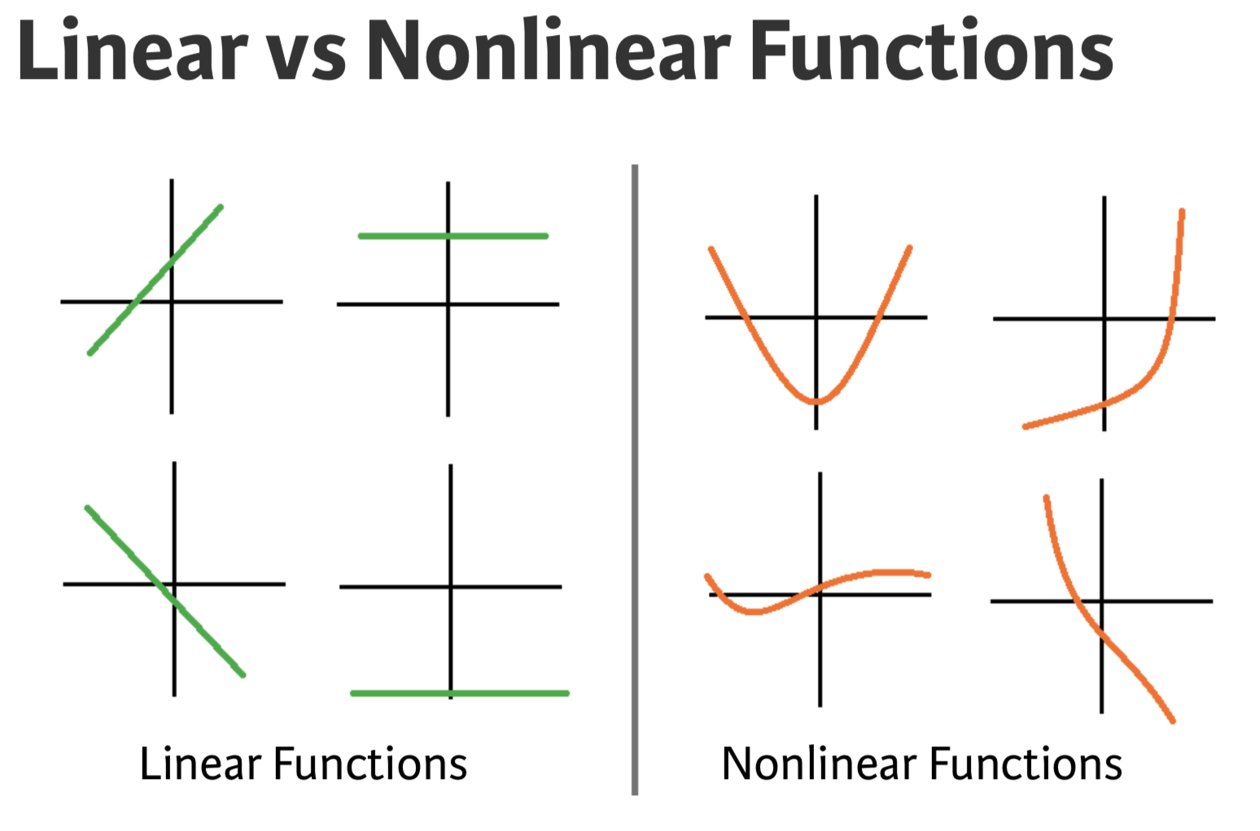
Activation Functions
Notes:
An artificial neural network is a network of simple elements called artificial neurons, which receive input, change their internal state (activation) according to that input, and produce output depending on the input and activation.
Explain the similarity between neural network and linear regression and how neural nets represent the interaction so well.
Deep neural network internally build up representation of patterns in the data, and they go through increasingly complex patterns as we go through successively hidden layers of the networks. Therefore, NN partially replace the need for feature engineering because as the layers increase, the more sophiscated the representations are built from raw data,

Slide 26
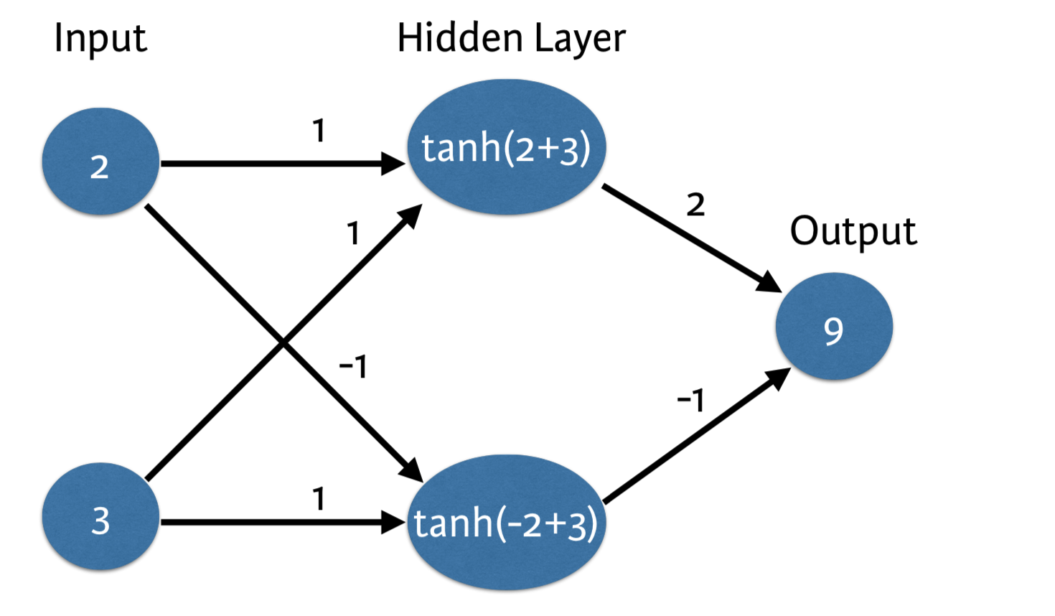
Activation Functions

Slide 27
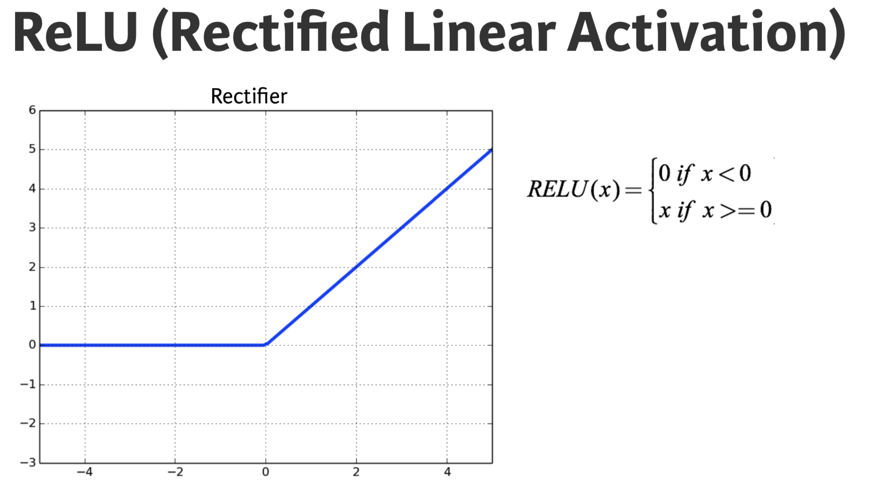
Activation Functions

Slide 28
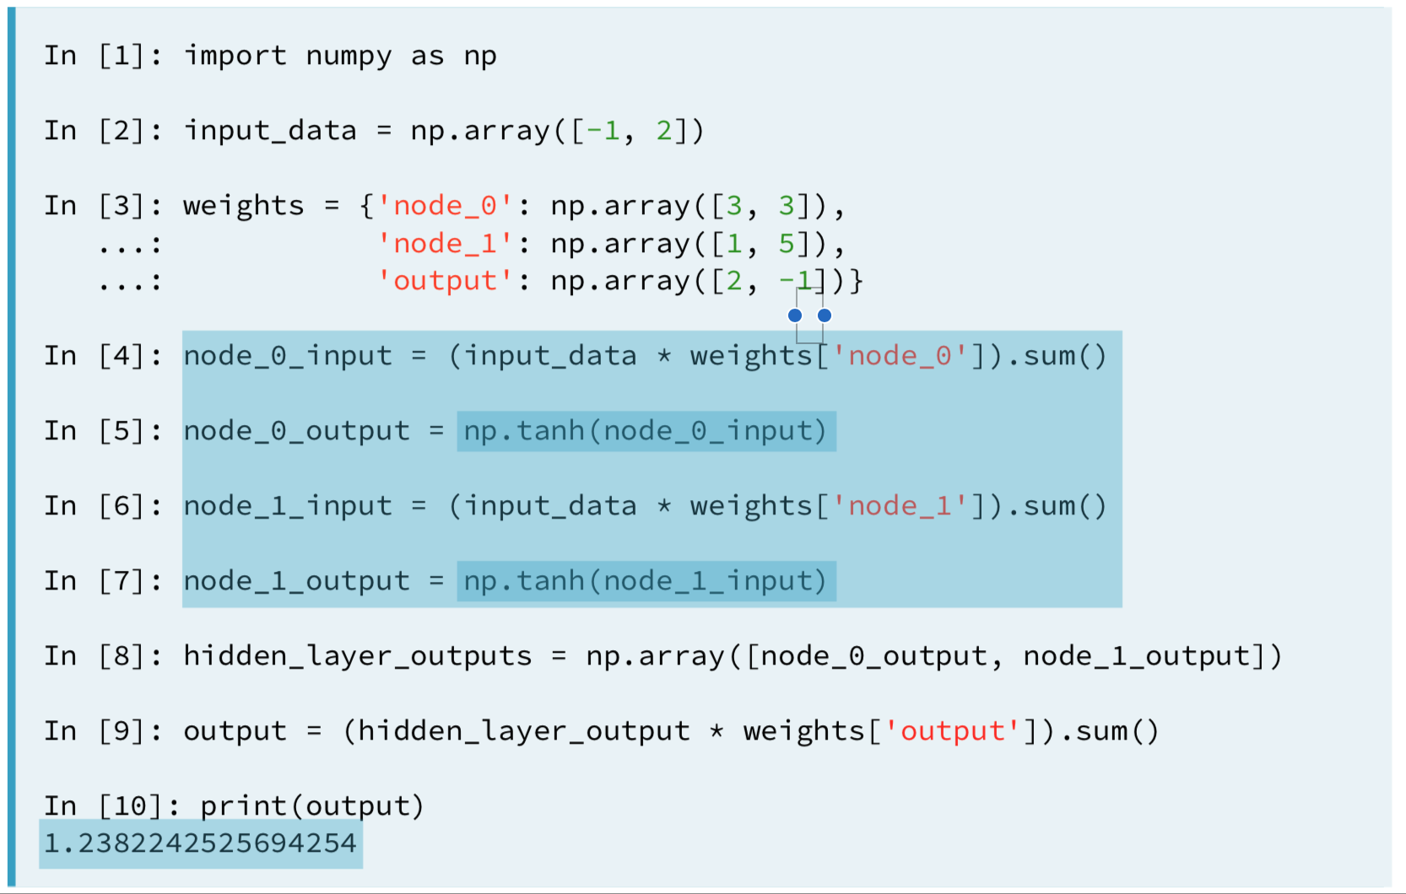
Activation Functions

Slide 29
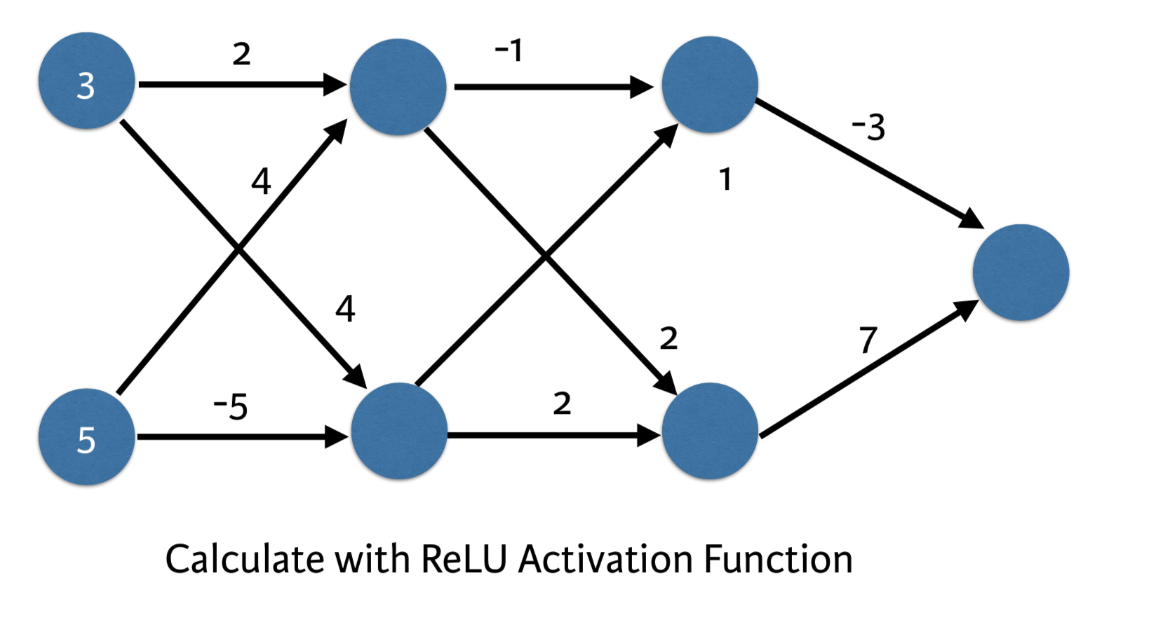
Deeper Networks

Slide 30
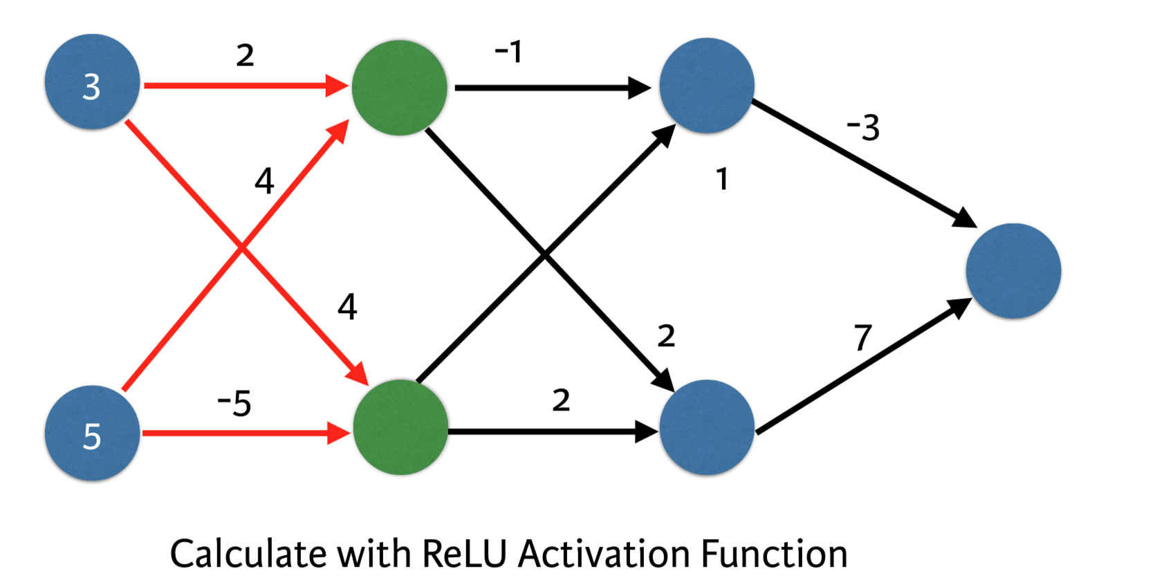
Deeper Networks

Slide 31
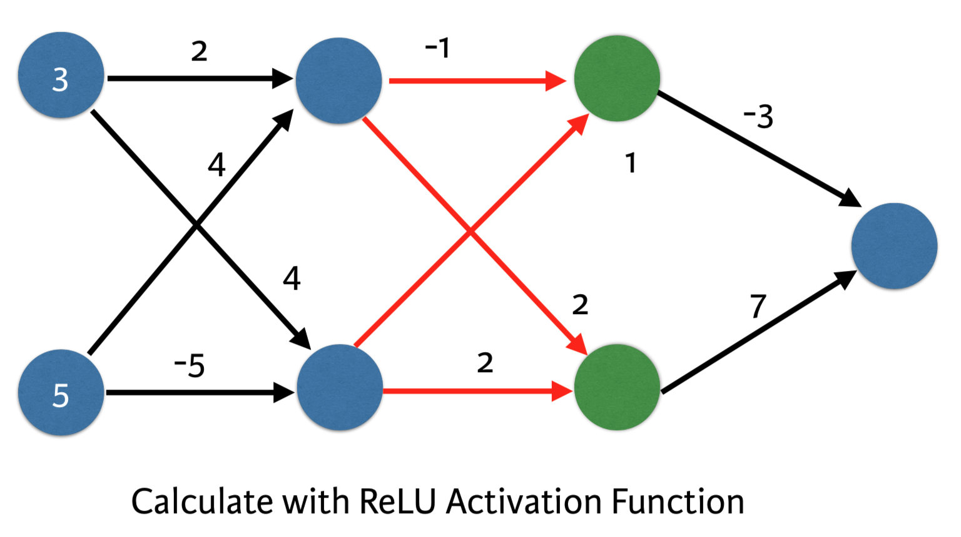
Deeper Networks

Slide 32
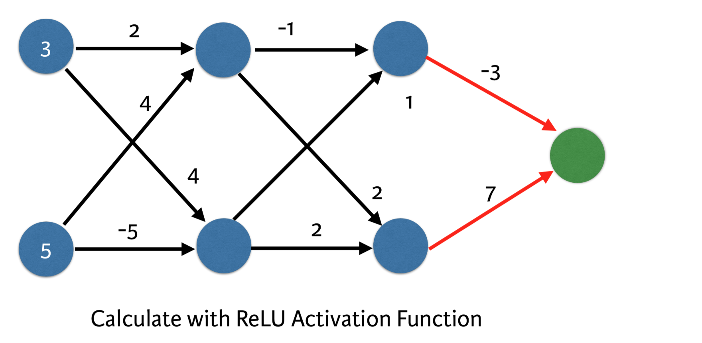
Deeper Networks

Slide 33
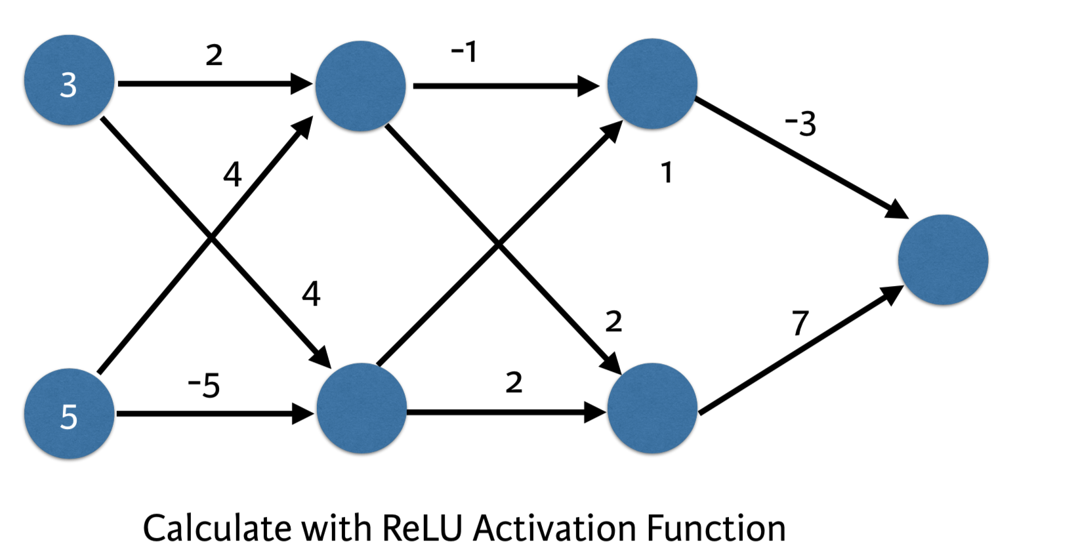
Deeper Networks

Slide 34
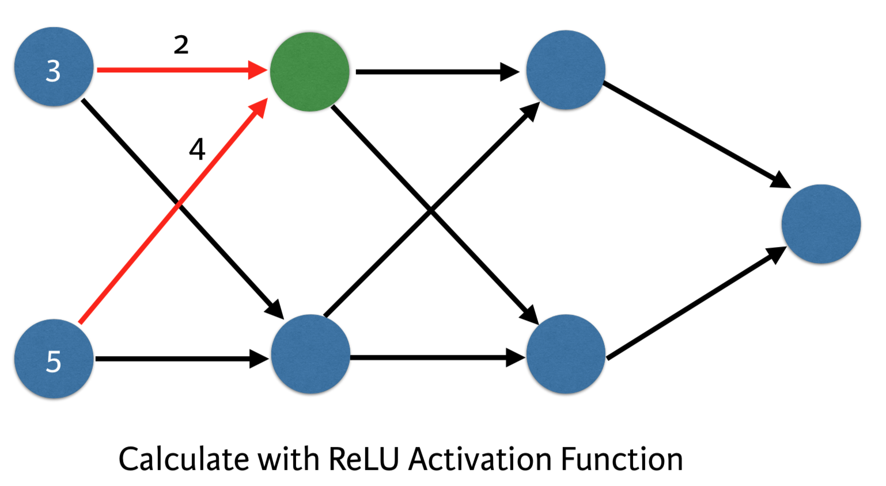
Deeper Networks

Slide 35
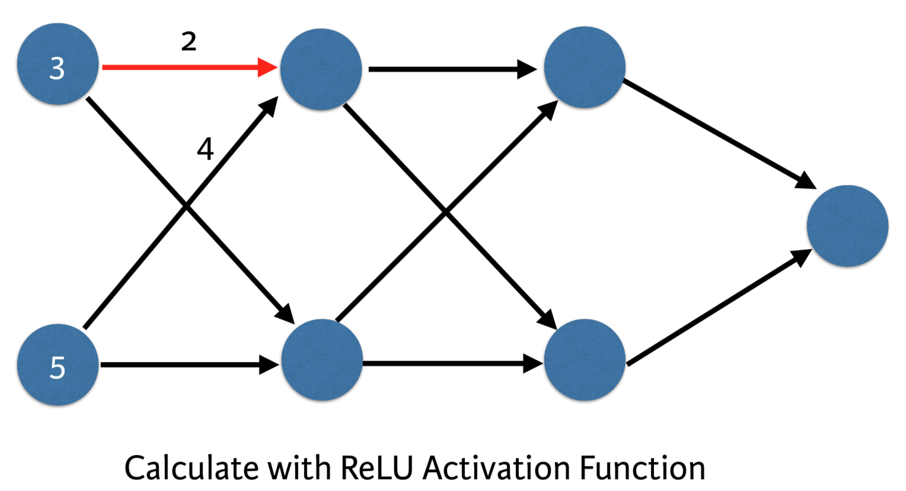
Deeper Networks

Slide 36
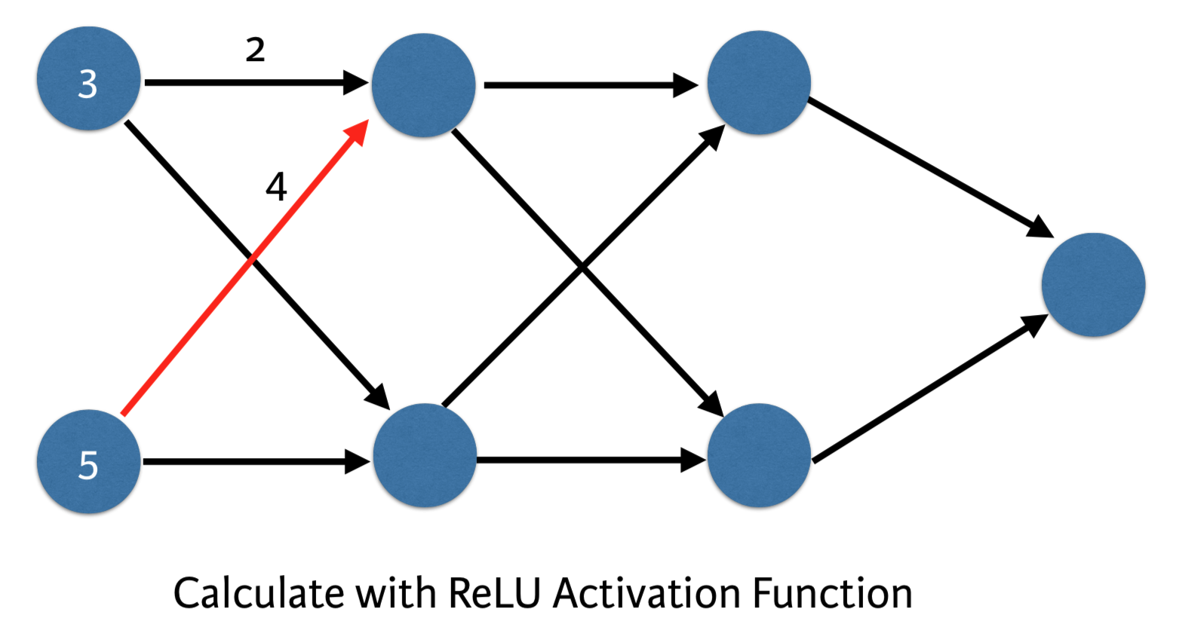
Deeper Networks

Slide 37
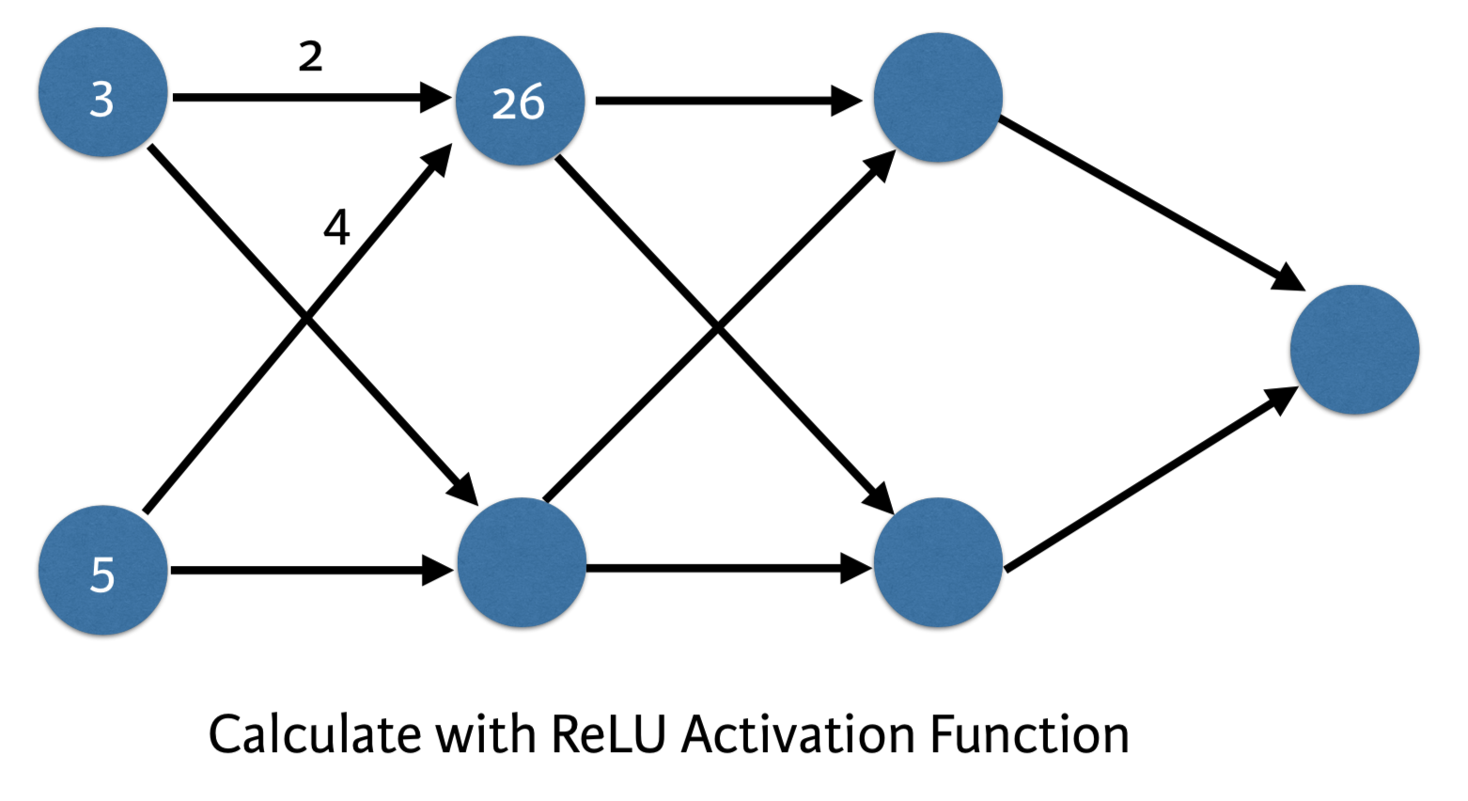
Deeper Networks

Slide 38
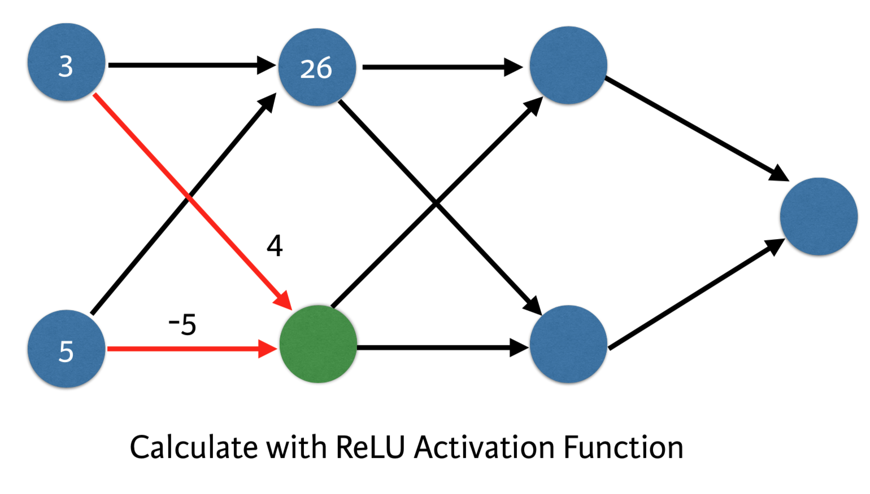
Deeper Networks

Slide 39
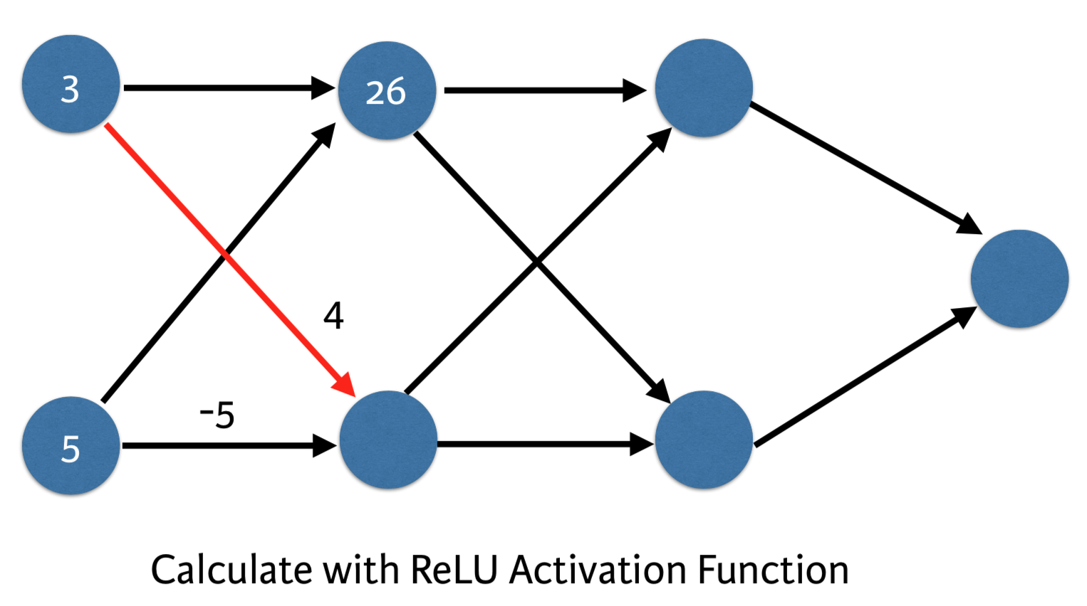
Deeper Networks

Slide 40
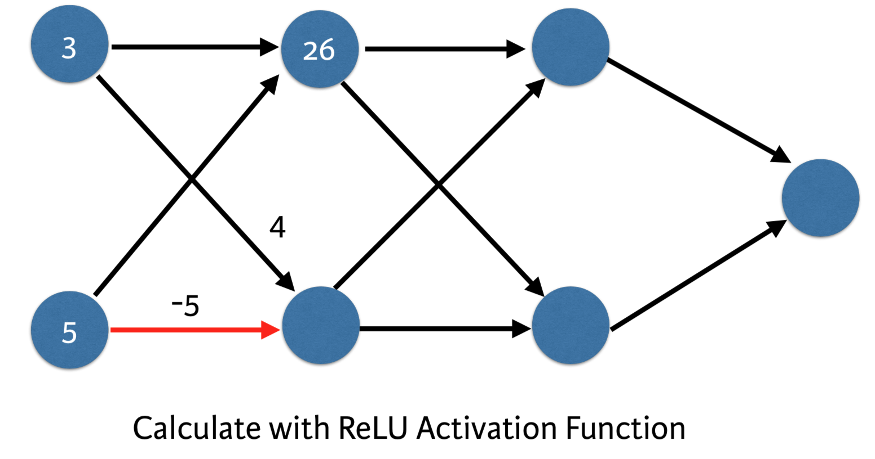
Deeper Networks

Slide 41
Activation Functions

Slide 42
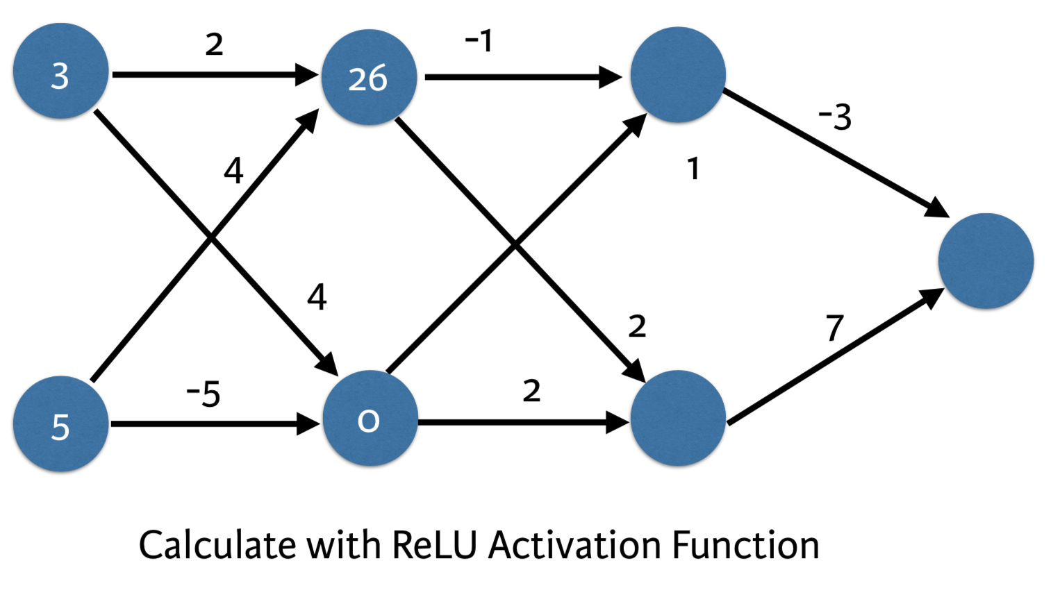
Deeper Networks

Slide 43
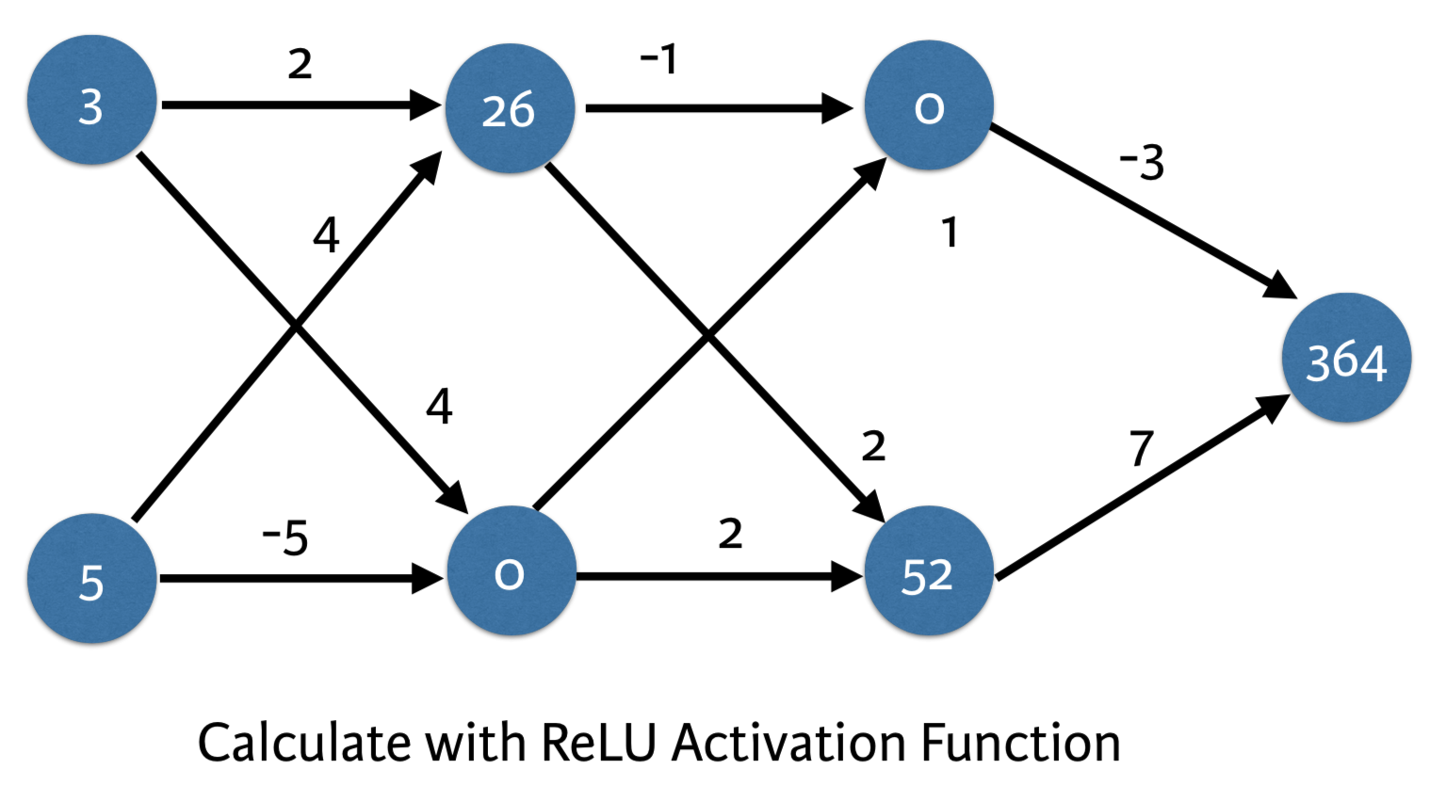
Deeper Networks

Slide 44
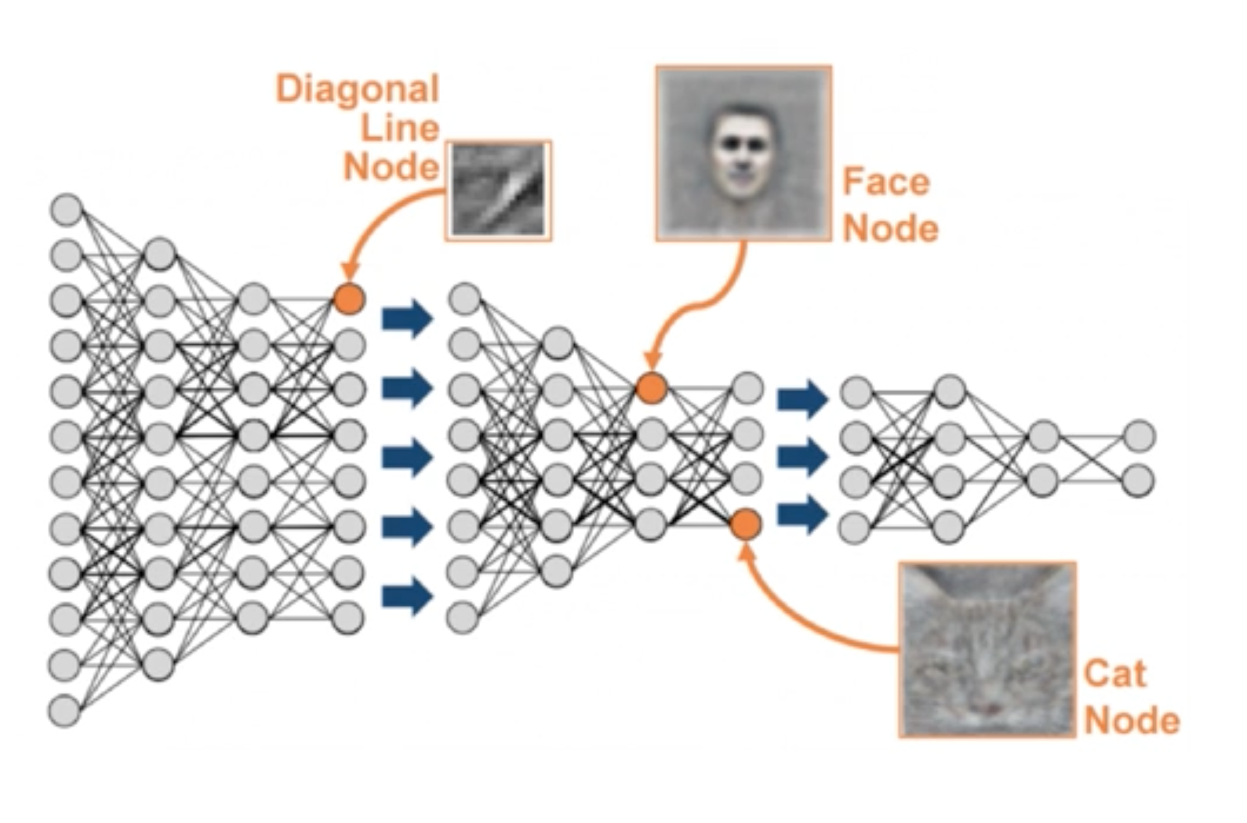
Why Neural Networks
Notes:
Explain the similarity between neural network and linear regression and how neural nets represent the interaction so well.
Deep neural network internally build up representation of patterns in the data, and they go through increasingly complex patterns as we go through successively hidden layers of the networks. Therefore, NN partially replace the need for feature engineering because as the layers increase, the more sophiscated the representations are built from raw data,

Slide 45
How Neural Nets work?
As mentioned earlier, neural networks can learn various patterns that underlie our data, structured and unstructured
The networks represent the pattern in our data by learning and adjusting the weight associated with each input at each layer
What we do to train our networks is assign a *weights* on the connection between our neurons and the next layer, and compute the weighted sum of that layer
We can then apply a certain activation function, e.g. Sigmoid, to confine the weighted sum between 0 to 1 to signify classes
We also want to apply a bias to our weighted sum, depending on the specific question
Notes:
Improving activation function

Slide 46
How Neural Nets work?
The weight associated with each neuron tells us which signal it’s picking up on
The bias controls how high or low the weighted sum needs to be before the neuron gets activated
Each neuron has its own weight and bias associated with the next layer, indicating the specific pattern
Deep learning → get our machines to learn the optimal weight and biases that model this process by propagating through multiple layers
The above process and be represented as the vectorized format
Notes:
Improving activation function

Slide 47
Different Types of Neural Networks
Convolutional Neural Networks
Recurrent Neural Networks
Long Short Term Memory
Generative Adversarial Neural Networks
Autoencoders
Notes:
https://towardsdatascience.com/the-mostly-complete-chart-of-neural-networks-explained-3fb6f2367464

Slide 48
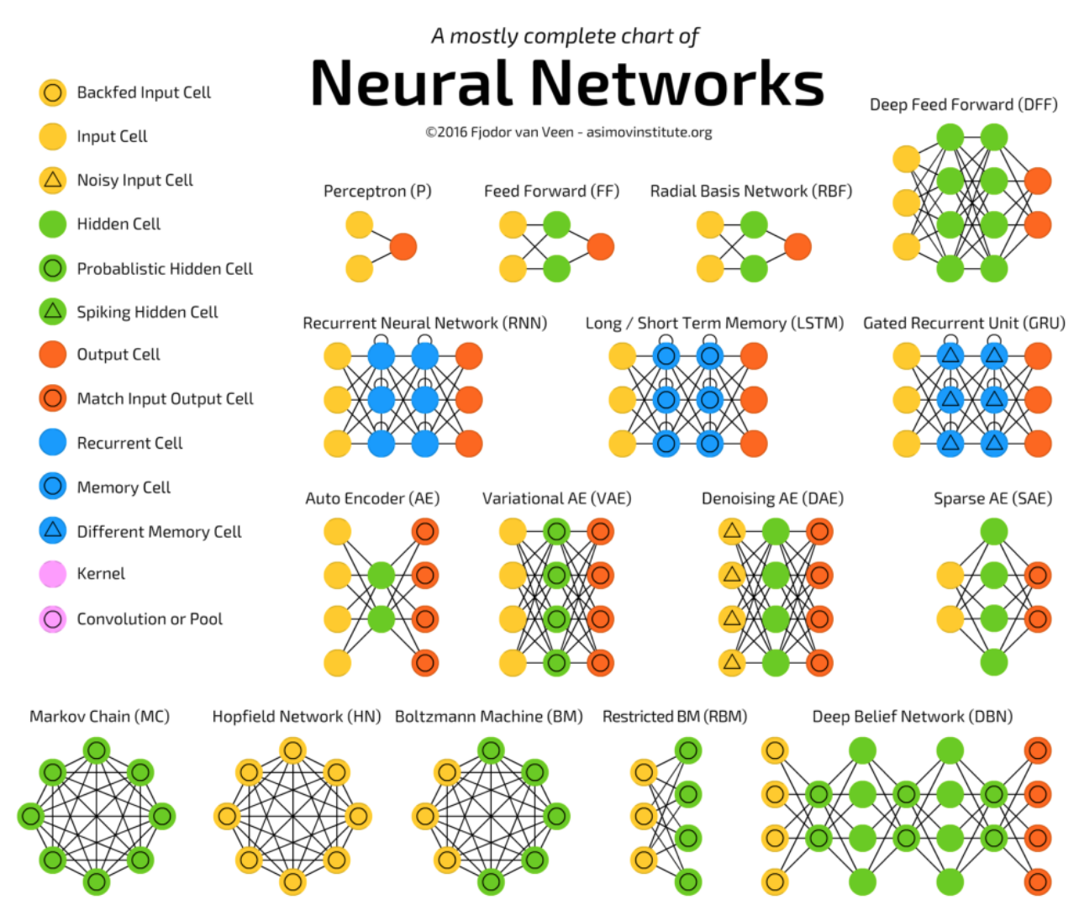
Different Types of Neural Networks
Notes:
https://towardsdatascience.com/the-mostly-complete-chart-of-neural-networks-explained-3fb6f2367464

Slide 49
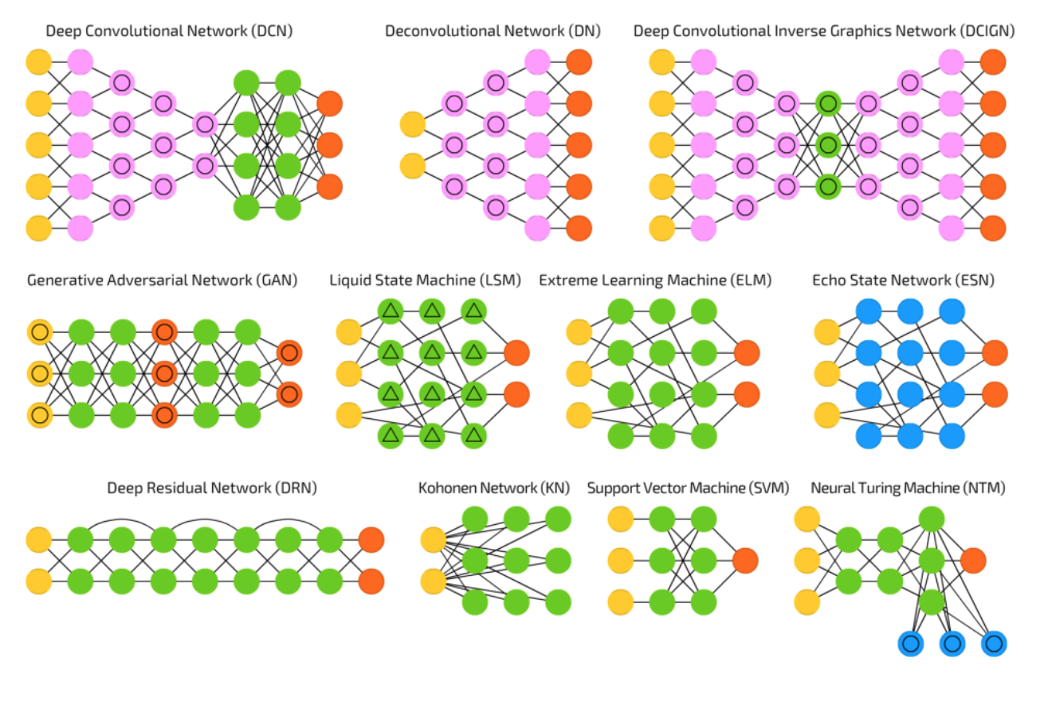
Different Types of Neural Networks
Notes:
https://towardsdatascience.com/the-mostly-complete-chart-of-neural-networks-explained-3fb6f2367464

Slide 50
Primary Tools for Deep Learning
Tensorflow
Torch/PyTorch
Keras
Caffe

Slide 51
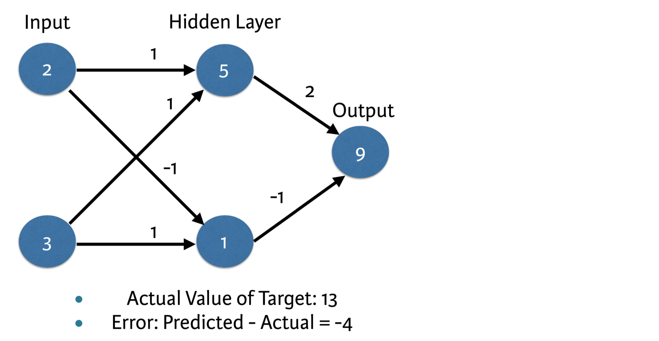
Optimizing our model
We can change the weights of the final layer to create a perfect prediction.
What should the new weights be?

Slide 52
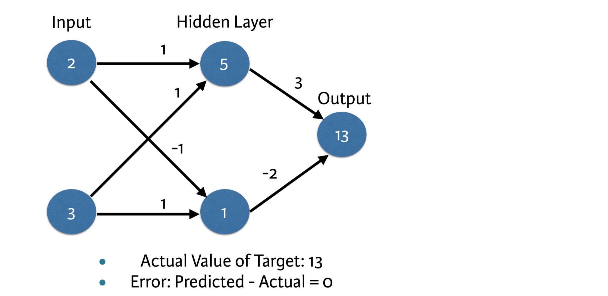
Updating Weights

Slide 53
Loss Function
In order to determine how we need to update our weights, we first must determine how bad our predictions are.
A loss function aggregates the errors in predictions from many data points into a single number, which is a measure of the model’s predictive performance.
Because we apply the function to multiple observations at once, we will always have some level of errors.

Slide 54
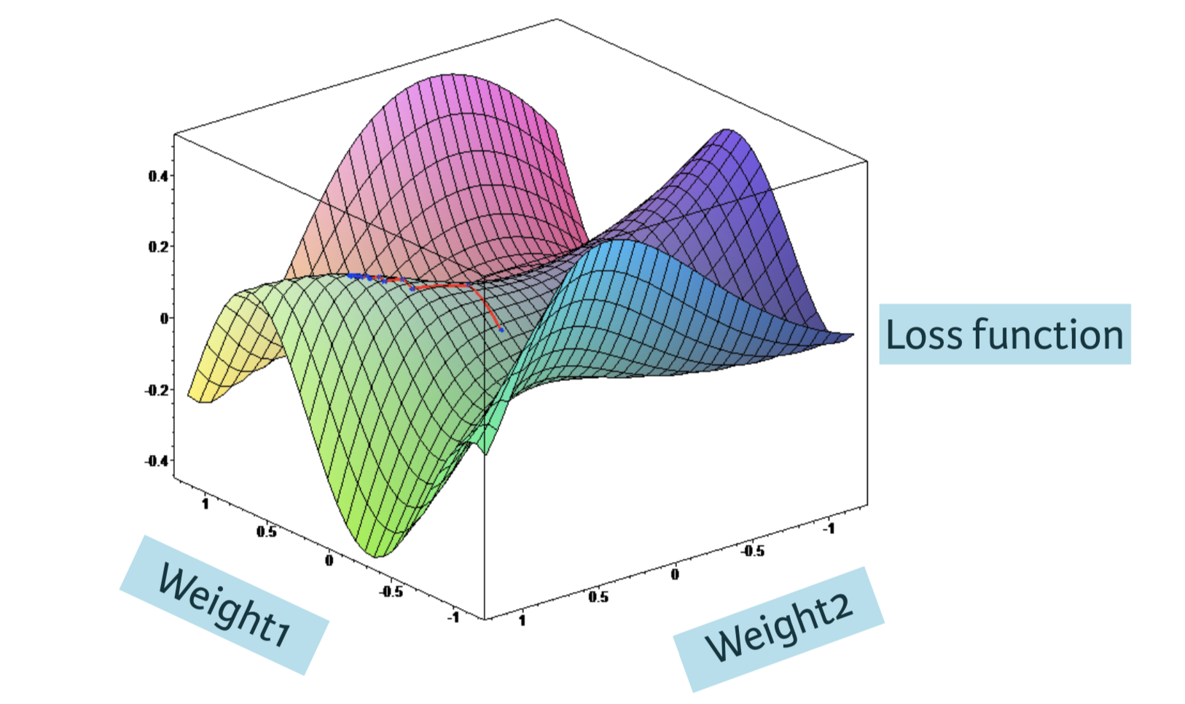
Loss Function

Slide 55
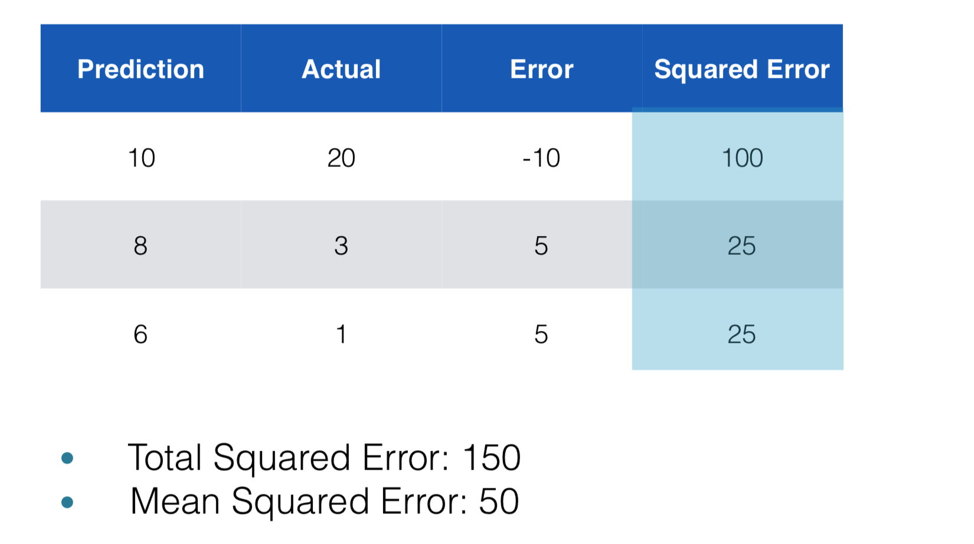
Calculating a loss function

Slide 56
Loss function
Lower loss function value means a be!er model
Goal: Find the weights that give the lowest value for the loss function
Gradient descent

Slide 57
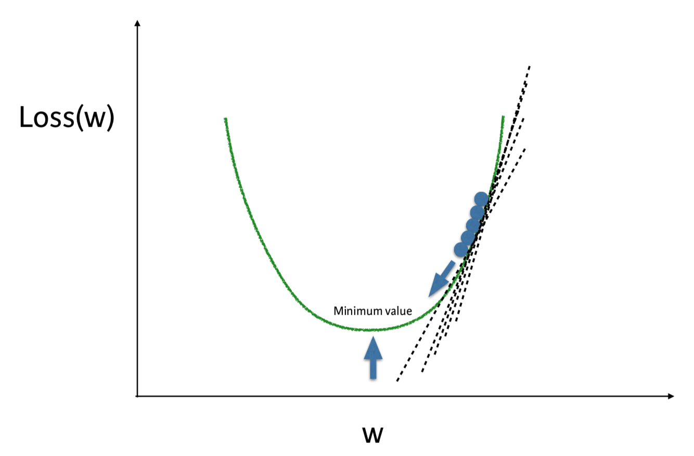
GRADIENT DISSENT
Start with some random values for the weights
Find the slope of the loss function at those weights.
Take a step in the direction that will reduce the error.
Continue until you reduce the slope to zero.
Practice!

Slide 58
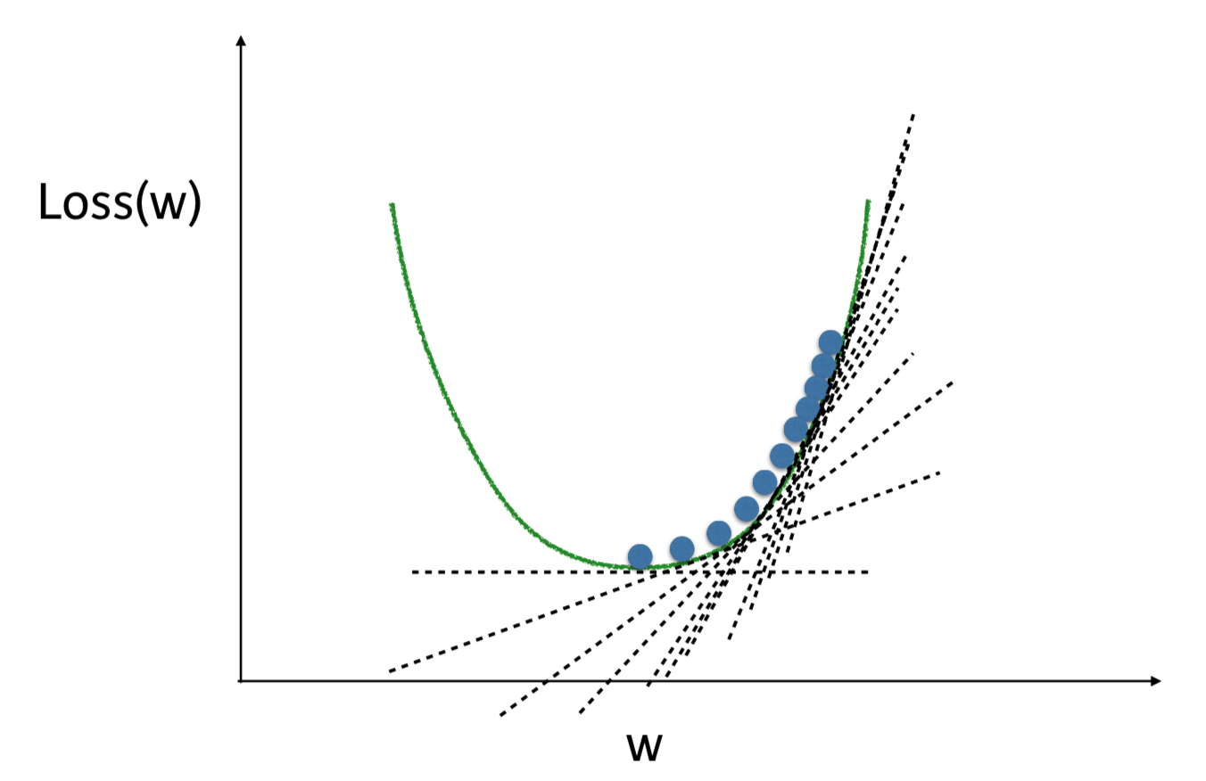
Gradient descent
If the slope is positive:
Going opposite the slope means moving to lower numbers
Subtract the slope from the current value
Too big a step might lead us astray
Solution: learning rate
Update each weight by subtracting
learning rate * slope

Slide 59
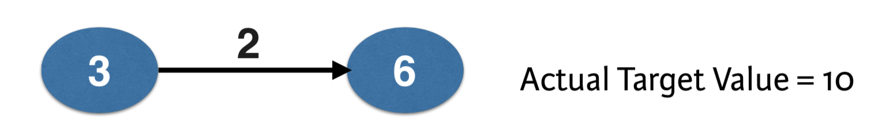
Updating weights
To calculate the slope for a weight, you need to multiply:
Slope of the loss function w.r.t. Value at the node we feed into
The value of the node that feeds into our weight
Slope of the activation function w.r.t value we feed into

Slide 60
Updating weights
Slope of mean-squared loss function w.r.t. Prediction:
2* (Predicted Value - Actual Value) = 2* Error
2* -4

Slide 61
Updating weights
To calculate the slope for a weight, you need to multiply:
Slope of the loss function w.r.t. Value at the node we feed into
The value of the node that feeds into our weight
Slope of the activation function w.r.t value we feed into

Slide 62
Updating weights
2 * -4 * 3
-24
If learning rate is 0.01, the new weight would be
2 - 0.01(-24) = 2.24

Slide 63
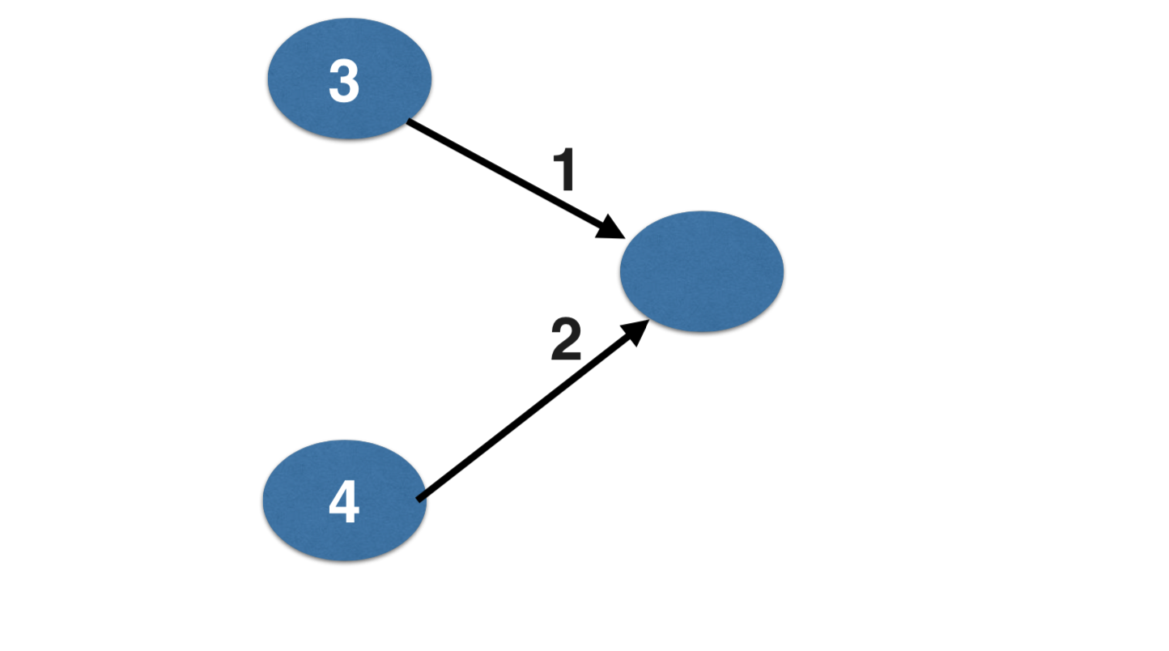
Working with multiple nodes

Slide 64
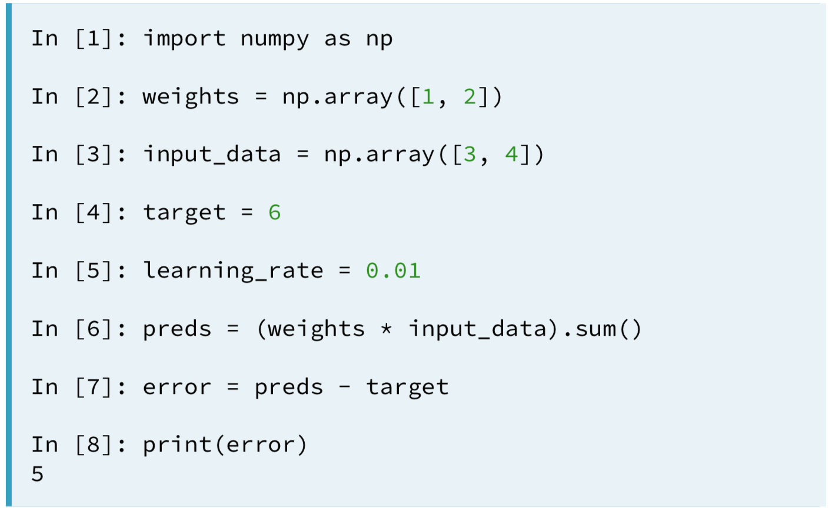
Code to calculate slopes and update weights

Slide 65
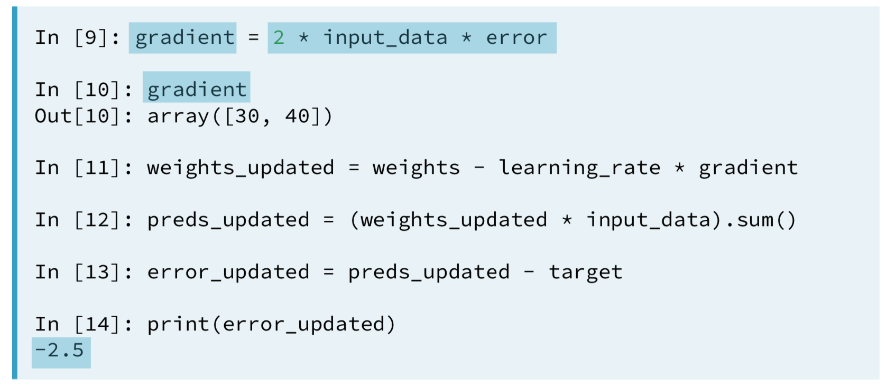
Code to calculate slopes and update weights

Slide 66
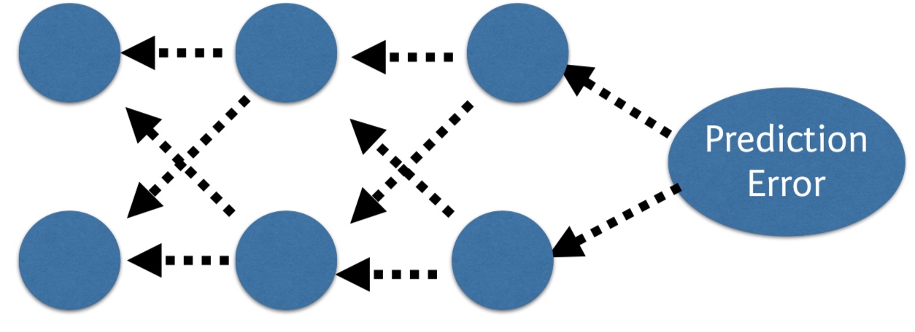
Backpropagation
Allows gradient descent to update all weights in neural network (by ge!ing gradients for all weights)
Comes from chain rule of calculus
Important to understand the process, but you will generally use a library that implements this

Slide 67
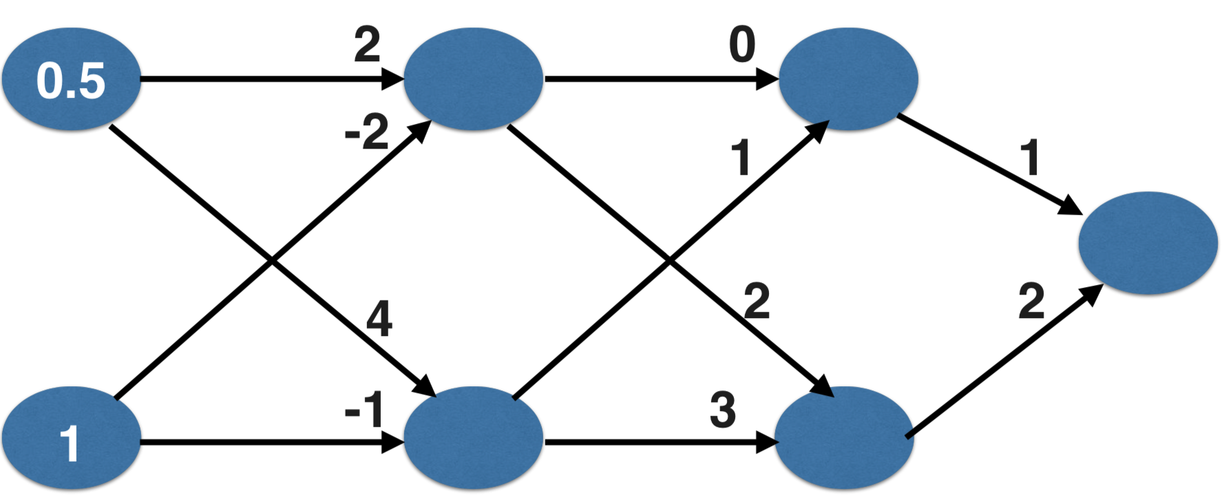
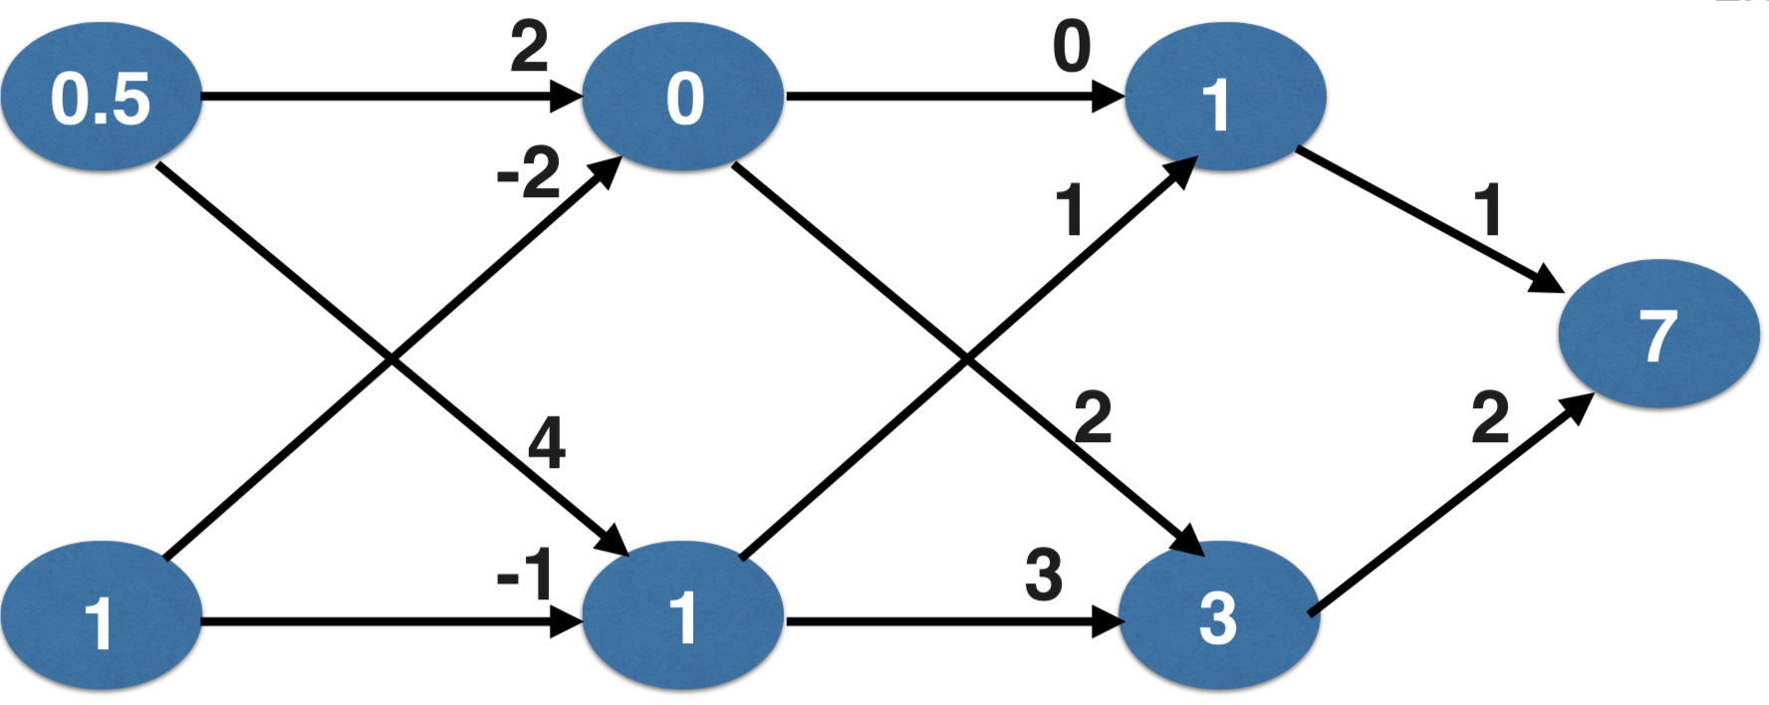
Backpropagation process

Slide 68
Backpropagation process
Go back one layer at a time
Gradient for weight is product of :
Node value feeding into that weight
Slope of loss function w.r.t. Node it feeds into
Slope of activation function at the node it feeds into
Trying to estimate the slope of the loss function w.r.t each weight
Do forward propagation to calculate predictions and errors

Slide 69
Questions
If you have gone through 4 iterations of calculating slopes (using backward propagation) and then updated weights, how many times must you have done forward propagation?
If your predictions were all exactly right, and your errors were all exactly 0, the slope of the loss function with respect to your predictions would also be 0. In that circumstance, which of the following statements would be correct?
The updates to all weights in the network would also be 0.
The updates to all weights in the network would be dependent on the activation functions.
The updates to all weights in the network would be proportional to values from the input data.

Slide 70
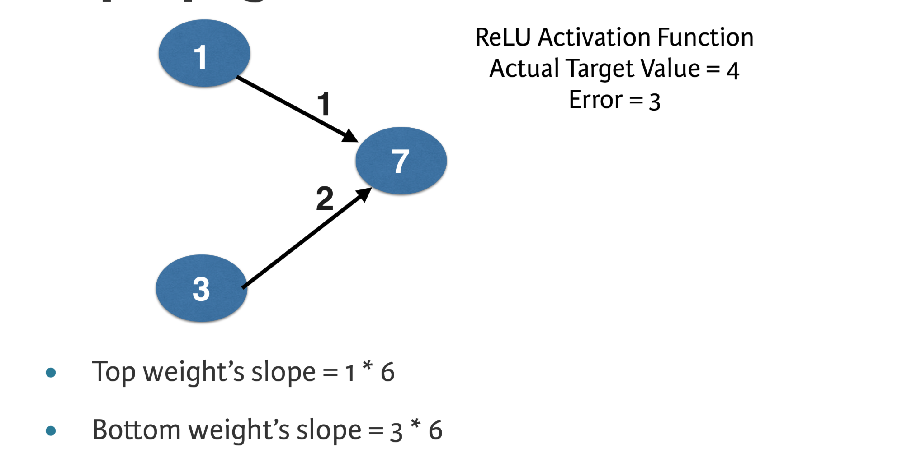
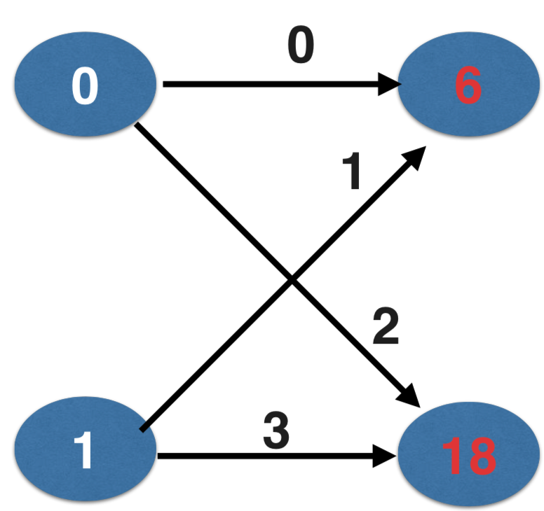
Backpropagation

Slide 71
Calculating slopes associated with any weight
Gradients for weight is product of:
Node value feeding into that weight
Slope of activation function for the node being fed into
Slope of loss function w.r.t output node

Slide 72
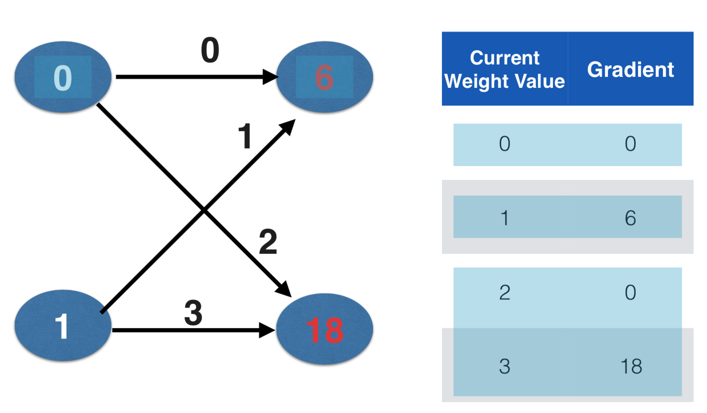
Backpropagation

Slide 73
Backpropagation: Recap
Start at some random set of weights
Use forward propagation to make a prediction
Use backward propagation to calculate the slope of the loss function w.r.t each weight
Multiply that slope by the learning rate, and subtract from the current weights.
Keep going with that cycle until we get to a flat part.

Slide 74
Stochastic gradient descent
It is common to calculate slopes on only a subset of the data (‘batch’)
Use a different batch of data to calculate the next update
Start over from the beginning once all data is used Each time through the training data is called an epoch
When slopes are calculated on one batch at a time: stochastic gradient descent

